Slide 1
Designing and Managing Azure Subscriptions
Notes:
Designing and Managing Azure Subscriptions
Why this session? Offers are multi-customer and potentially multi-tenant vehicles. Failing to get the right subscription architecture could be disastrous.
Session Goals
Discuss key limitations and how these affect architectures.
Benefits of different subscription types + DPOR.
Guidance on who should own the subscription and how this relates to offer design.
Duration - 30 minutes
Demos
To be added/changed
System Integrators are increasingly offering managed services to operate strategic solutions on behalf of their customers. This session discusses how subscription management affects these solutions, and how subscription limits impact architecture of solutions.

Slide 2
Agenda
Subscription Design
Subscription management
Access Control, Billing, and Usage
Subscription governance

Slide 3
Subscription Design

Slide 4
What is an Azure Subscription?
Governs the following:
Billing relationship
Account administration
Role Based Access Control (RBAC) to artifacts
Boundaries/Limits
Boundaries
Usage and billing (rate card based on offer numbers)
Limits
Virtual Network
Attached to 1 AAD (1 AAD be associated with many subscriptions)
Associated to an enterprise enrollment account
Notes:
See https://azure.microsoft.com/en-us/support/legal/offer-details/ for offer codes

Slide 5

Enterprise Azure Roles and Portals
https://ea.windowsazure.com
Enterprise Administrator
Enterprise Enrollment
Department Administrator
Department
Department
https://account.windowsazure.com
Account Owner
Account
Account
Account
https://portal.azure.com
Service Administrator
Subscription
Subscription
Subscription
Subscription
Notes:
To administer your Microsoft Azure services under your Enrollment, there are three distinct administrative roles: the Enterprise Administrator, the Account Owner and the Service Administrator. Users are required to authenticate using a valid Microsoft Account (LiveID http://signup.live.com) or Organizational Account (Cloud-based Active Directory). Make sure the ID entered is associated with a monitored mailbox as enrollment and account notifications will be sent to this mailbox.
The roles complete tasks on three different Microsoft Azure portals. The Enterprise Portal, the Account Portal and the Management Portal.
Enterprise Administrator The Enterprise Administrator has the ability to add or associate Accounts to the Enrollment, can view usage and charges data across all Accounts and Subscriptions, can view the monetary commitment balance associated to the Enrollment. There is no limit to the number of Enterprise Administrators on an Enrollment. You can also add a Notifications Contact that can receive all email notifications. The EA portal is all about billing and usage, enabling the Enterprise Administrator to view billing and usage across all accounts.
Account Owner The Account Owner can add Subscriptions for their Account, update the Service Administrator and Co-Administrator for an individual Subscription, view usage data for their Account, and view Account charges if the Enterprise Administrator has provided access. The Account Owner will not have visibility of the monetary commitment balance unless they also have Enterprise Administrator rights.
Service Administrator The Service Administrator and Co-Administrators per Subscription have the ability to access and manage Subscriptions and development projects within the Azure Management Portal. The Service Administrator does not have access to the Enterprise Portal unless they also have one of the other two roles.

Slide 6
Account Setup Methodology
Functional
Business Division
Geographic
Enterprise
Enterprise
Enterprise
Accounts
Finance
Marketing
Automotive
Life Sciences
North America
Europe
Subscription 1
Subscription 2
Subscription 3
Subscription 4
Subscription 5
Subscription 6
Subscription 7
Subscription 8
Subscription 9
Notes:
Choosing the right account set up methodology for your organization is an important first step in setting up your Accounts. How you set up your Accounts and Subscriptions will impact how they are administered and how they are reflected on your enterprise level reports. This is all done by setting or editing the Account Name field. Examples of typical set up methodologies include structuring by:
Functional Teams - Finance, Marketing, Sales, etc.
Geographic Locations - North America, Europe, Asia, etc.
Business Divisions - Automotive, Aerospace, Medical, etc.
Applications - Application 1, Application 2, etc.

Slide 7
Subscription Limits (subset)
Azure Resource | Resource Manager API | Service Management API
Cores per subscription | 20/10,000 per region | 20/10,000 Global
Co-administrators per subscription | Unlimited | 200/200 Global, with no RBAC model
Storage accounts per subscription | 100/100 (250 by contacting support) | 100/150 (250 by contacting support)
Cloud Services per subscription | N/A | 20/200
Virtual networks per subscription | 50/500 | 50/100
Local networks per subscription | 10/500 | 20/Contact support
Reserved IPs per subscription | 20/100 | 20/Contact support
Public IP addresses (dynamic) | 60/Contact Support | 400 Global
Reserved public IP addresses | 20/Contact support | 256 Global
Resource Groups per subscription | 800/800 | 500 Global
Virtual machines per subscription | 20/10,000 per region | 50/50 per cloud service
https://azure.microsoft.com/en-us/documentation/articles/azure-subscription-service-limits
Notes:
Updated 06/03/2016
This slide is an eye chart, but it tells an important story: subscriptions have limits. You cannot simply create a single subscription, you need to design according to limits. These limits also differ if you are using the old Azure Management Portal, which uses the Service Management API, or the new portal, which uses the Azure Resource Manager API.
Format is Default/Maximum so 20/200 = 20 default, 200 maximum
aka.ms/azurelimits

Slide 8
Subscription Setup Methodology
Enterprise
Account
Account
Application 1
Application 2
Application 3
Sub. 1 - Development
Sub. 4 - Development
Sub. 5 - Development
Sub. 2 - Staging
Sub. 6 - Staging
Sub. 3 – Production
Sub. 7 – Production
Notes:
Only the Account Owner has the ability to create Subscriptions. Subscriptions may have any combination of services associated to them.
Creating different Subscriptions for each environment of your applications and assigning a different Service Administrator and Co-Administrators to each subscription can be used to help control access to development projects and environments within your organization. It also helps avoid performance boundaries, such as number of storage accounts per subscription and total IOPS per storage account.
If you are managing your customer’s environment, you will need to account for these boundaries.

Slide 9
Subscription Management

Slide 10
How do I manage an Azure Subscription?
Service Manager Roles
Account administrator (create, cancel, billing)
Service administrator (Same as account admin)
Co-Administrator (Can’t change Azure AD, billing, create, etc.)
Account types
Personal (Microsoft Accounts)
Organizational Accounts (Azure AD)
O365/Intune/CRM/EMS
Azure AD created
Can add additional services/subscriptions
As a Partner
Partner manages (On behalf of)
Resource Manager Roles
Role based access via assignment
Partner pays for (service provider model)

Slide 11
How do I mange someone else's subscription?
Transfer
Management certificate
Limit 100 management certificates per subscription
User Id in subscription (service administrator)
Limited in management scope
User id in resource group
Limited in management scope
Notes:
https://azure.microsoft.com/en-us/documentation/articles/billing-subscription-transfer/

Slide 12
Management Portals
Manage access
Manage accounts
Manage subscriptions
View price sheet
View usage summary
Manage usage & lifecycle email notifications
Manage Authentication Types
Account Portal (https://account.windowsazure.com
Enterprise Portal (https://ea.azure.com/
Edit subscription details
Enroll in or enable Preview features
Management Portal (https://manage.windowsazure.com or https://portal.azure.com
Manage co-administrators on subscriptions
Open support tickets for issues within the subscription
Provision/de-provision Azure services
Manage Market place access

Slide 13
Manage subscriptions using PowerShell (POSH)
Notes:
Get-AzurePublishSettingsFile – will pop UI to get a management cert
Import-AzurePublishSettingsFile “PATH\*.publishsettings”
Get-AzureAccount
Get-AzureSubscription
Update-Help

Slide 14
View subscriptions using visual studio

Slide 15
Manage subscriptions using command-line interface (CLI)
Notes:
azure login
azure login -u user@contoso.onmicrosoft.co
azure logout -u <username>
azure account download
azure account import <path to your .publishsettings file>
azure config mode arm
azure location list

Slide 16
Access Control, Billing, and Usage

Slide 17
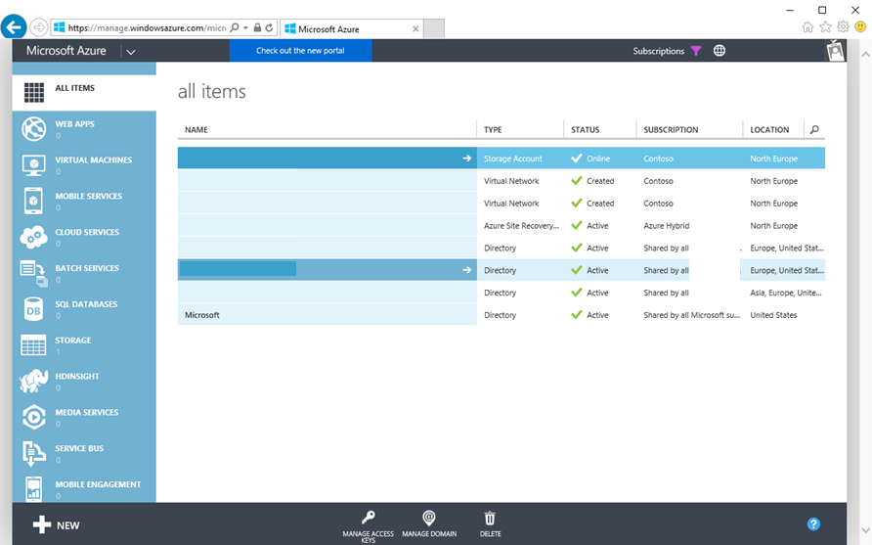
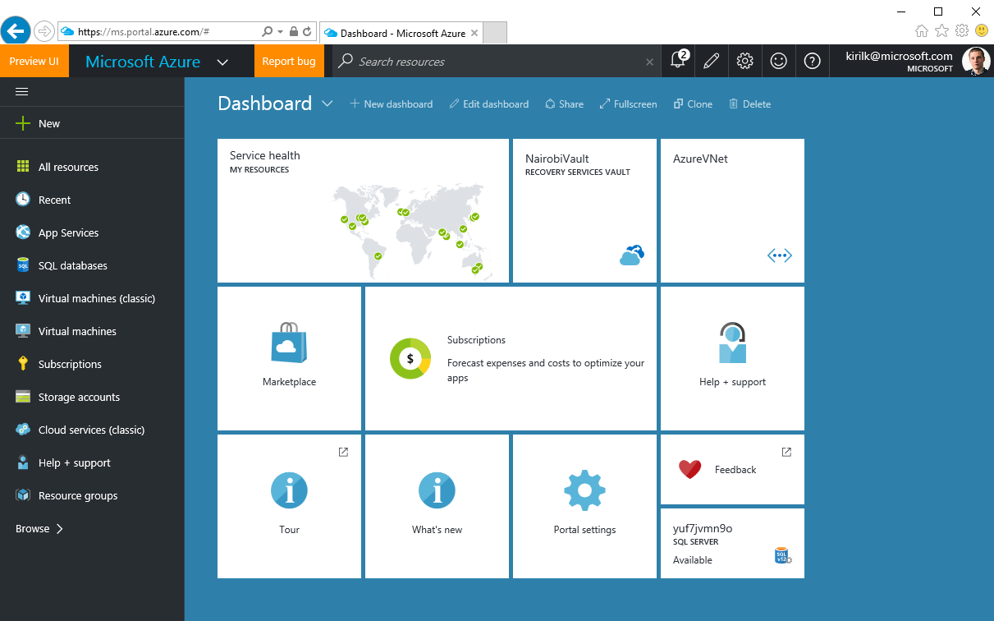
2 generations of Azure
Azure Service Management (ASM)
Azure Resource Manager (ARM)
https://manage.windowsazure.com
No Role Based Access Control
Not available in CSP
https://portal.azure.com
Resource Groups & Tags
Role Based Access Control
Notes:
Role Considerations
Azure Resource Management (ARM) environment, a subscription now has two administrative models: Service Management and Azure Resource Management. With ARM the subscription is no longer needed as an administrative boundary. ARM provides a more granular Roles Based Access Control (RBAC) model for assigning administrative rights at the resource level. RBAC is currently being released in stages, 22 new roles have been released and user defined roles is coming in a future release. There will be some complexity during the coexistence of the service management and resource management environments and will need to be carefully considered.

Slide 18
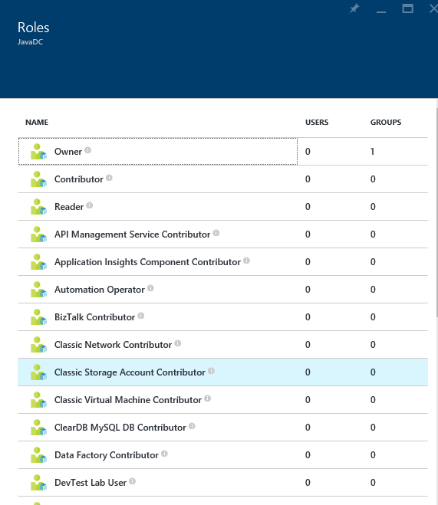
Role Based Access Control
Allows secure access with granular permissions
Assignable to users, groups, or service principals
Built-in roles make it easy to get started
NOTE – RBAC in ARM applies to resources exposed via ARM. Software inside of VMs which may have it’s own security mechanisms and should be considered during design.
Notes:
ARM provides role-based access control, integrating with the Azure Active Directory directory associated with your subscription. This allows you to limit access to resource groups or resources to specific users or groups. There are built-in roles, such as “Virtual Machine Contributor” that lets you manage virtual machines, but not the access to them, and not the virtual networks or storage they are connected to.
It’s important to note RBAC in ARM applies to resources exposed via ARM. Software inside of VMs which may have it’s own security mechanisms and should be considered during design.

Slide 19
Role Based Access Control
Notes:
Access is inherited in the RBAC model. Contributors, owners, and readers assigned at the subscription level have access to the resource groups and resources within that subscription. This can be useful when monitoring all resources deployed to a subscription.
A user assigned as a contributor, owner, or reader of a resource group has access to that resource group and everything contained within it. This can be useful when monitoring a group of resources that comprise an application.
Users and roles can be assigned at the resource level. You might assign a reader for a specific resource so they can see, but not modify, a resource. This can be useful when monitoring a specific resource.

Slide 20
Resource Tags
Name-value pairs assigned to resources or resource groups
Subscription-wide
Each resource can have up to 15 tags
x15
Notes:
Tags can be applied to resource groups or individual resources, and these tags appear within your usage and billing statement. This enables you to track consumption against individual IO codes, projects, or other taxonomies. You can apply up to 15 tags per resource and resource group. Tags may be placed on a resource at the time of creation or added to an existing resource.

Slide 21
Tagging Tips
Tag by environment, e.g. dev/test/prod
Tag by role, e.g. web/cache/db
Tag by department, e.g. finance/retail/legal
Tag by responsible party, e.g. Bob
x15

Slide 22




RateCard API and Usage API
Microsoft Azure
Your Application
Actionable Insights
My workload will cost $368 in Azure
I can save $35 by moving my compute workload from east-us to north-europe
My HR department’s application’s cloud charges were $35 for the past month
RateCard API
(pricing rates)
Pricing insights
Usage API
(usage data)
Usage insights
https://github.com/Azure/BillingCodeSamples
Notes:
Azure Usage API – A REST API that customers and partners can use to get their usage data for an Azure subscription. As part of this new Billing API we now correlate the usage/costs by the resource tags you can now set on your Azure resources (for example: you could assign a tag “Department abc” or “Project X” to a VM or Database in order to better track spend on a resource and charge it back to an internal group within your company). To get more details, please read the MSDN page on the Usage API. Enterprise Agreement (EA) customers can also use this API to get a more granular view into their consumption data, and to complement what they get from the EA Billing CSV.
Azure RateCard API – A REST API that customers and partners can use to get the list of the available resources they can use, along with metadata and price information about them. To get more details, please read the MSDN page on the RateCard API.
Note to speaker: The RateCard API does not currently include EA pricing models during preview.

Slide 23
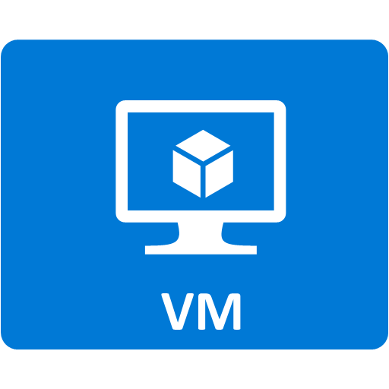



Demo Architecture
Resource Group
IO Code
Virtual Machine Contributor
Availability Set
Machine Type
Machine Type
VM0
VM1
Storage
Virtual Network
Network interface
Network interface
Load balancer
Notes:
The previous demonstration showed how to use a template to provision resources to a resource group. This demonstration will show how to apply tags and role-based access control. We will apply a custom tag, “IO Code”, to the resource group, apply a custom tag “Machine Type” to the virtual machines, and assign the group role “Virtual Machine Contributor” to the resource group.

Slide 24
RBAC and Tagging

Slide 25
Subscription Governance

Slide 26
Subscription Considerations
Management approach
Single team or cross-organizational
Role Based Access Control (RBAC)
Security requirements
Data or network security
Environments - Sandbox, Dev, Test, UAT, Pre-Prod, Prod
Connectivity requirements
Single point of ingress?
Multiple regions?
Application requirements
Data flow
Compliance

Slide 27
Azure Resource Manager Policies: Scenarios
Chargeback: Require departmental tags
Geo Compliance: Ensure resource locations
Service Curation: Select your service catalog
Convention: Enforce naming

Slide 28
Key Learnings from Enterprise Customers
Work or School Accounts not Microsoft Accounts
Use organizational accounts to sign-up and manage Azure. Connect your Azure AD with on-prem AD.
Resource Groups not Subscriptions
Use resource groups to segregate workloads with different access needs. Avoid granting access to individual resources unless necessary.
Manage Access using Groups
Assign access to AD groups, manage membership of groups for on-going access management.
Enable Multi-Factor Auth
Use Azure AD conditional access policies to enable MFA for Azure management.
Least Privilege
Pick the right role for the job. Contributor not Owner. Model on-premises roles using resource-type specific Azure roles.
Keep a tab on Access Changes
Monitor changes to access settings. Regularly dump and review entire access policy.

Slide 29
Subscription Design Guidance (General)
Control # of subscriptions
Identity Management
Use Customer Azure Active Directory for Azure Governance roles
Add at least one more Enterprise Administrator
Use Functional Accounts not Named Accounts for Roles. Specially for Account Owners and Service Administrators
Security and Identity
If the subscription includes Azure Active Directory, IaaS Domain Controllers, or connects to Domain Controllers from an on-premises active directory, the Subscription administrators and Co-administrators are de-facto domain owners as well.
Scale
Subscriptions form the scale unit in Azure. Many resources, from computing cores, and storage accounts, to reserved IP addresses all have quantity and size limitations based on the subscription.

Slide 30
Subscription Design Guidance (Networking)
Connectivity
The subscription is a required container to hold a virtual network, and oftentimes networking is a shared resource within an enterprise
Administration and Connectivity are often at odds with respect to autonomy and sharing resources
Express Route
Minimize #subscriptions (take network requirements and ER boundaries into account)
10 virtual networks can be attached to a single ExpressRoute standard circuit, so at most 10 subscriptions could be attached to that circuit (Premium varies from 20-100)
Notes:
https://azure.microsoft.com/en-us/documentation/articles/azure-subscription-service-limits/#limits-and-the-azure-resource-manager

Slide 31
Key Decisions
Identify a Subscription Model
Establish “first subscription” using new model
Finalize on the number of Departments, Accounts, Subscriptions & administrators for each
Identify who will be managing the subscription
Service (Subscription) Administrators, Co-Administrators
Identify key RBAC roles within your organization
Start small, expand later
Focus on built-in roles

Slide 32
Key Decisions
Naming convention is a key decision for object management, tracking, and billing
Pick names that will give you information in the portal
Make it easy to understand what a resource is for
Use tagging to set the context that you do not need in the name
Maybe you do not need to indicate if something is production or non-production in the name, but do it with a tag
Outline initial Azure naming convention

Slide 33
Naming Conventions in Azure

Slide 34
Naming Conventions
Importance
Places the naming pattern in an order that allows easier application level grouping for potential showback/chargeback billing.
Automation.
Consideration
Some resource names are:
Requirements
Ensure:
Constrained by length.
Constrained to alpha-numeric.
Constrained unique within account
Cannot contain offensive or forbidden substrings.
Case sensitivity requirements
Application association
Environment association
Region association
Instance association
Object association
Describes type of resource in the subscription.
Unique Azure naming
Constrained unique across entire Azure.
Cannot include upper case characters.

Slide 35
Subscription Naming (Example)
Subscription Naming Convention Considerations
It is a recommended practice to be verbose:
<Company> <Department (optional)> <Product Line (optional)> <Environment>
Example
Company | Department (OU) | Product Line | Environment | Full Name
Contoso | Services | Business | Dev | Contoso Services Business Dev
Contoso | Services | Business | Lab | Contoso Services Business Lab
Contoso | Services | Business | Prod | Contoso Services Business Prod
Contoso | Services | Consumer | Dev | Contoso Services Consumer Dev
Contoso | Services | Consumer | Lab | Contoso Services Consumer Lab
Contoso | Services | Consumer | Prod | Contoso Services Consumer Prod
North Wind | Databases | Business | Dev | North Wind Databases Consumer Dev
North Wind | Databases | Business | Lab | North Wind Databases Consumer Lab
North Wind | Databases | Business | Prod | North Wind Databases Consumer Prod

Slide 36
Azure Naming Constraints Examples
Some resource names are constrained-Must be globally unique across Azure
e.g., SQL Server Name, Storage Account Names, etc.
Some resource names are constrained by length
e.g., Search Service is constrained 2 to 15 characters
Some resource names are constrained to alpha-numeric
e.g., Storage Account Name cannot have dash, dots, etc.
Some resource names must be unique within the subscription
e.g., Storage Table Name must be unique within Azure storage account
Some resource names cannot be upper characters
e.g., Storage account names must be all lower case

Slide 37
Azure Naming Convention (Example)
1
Divide the naming into segments
2
Create abbreviations for environments and resources (VMs and Objects)
Segment A | Segment B | Segment C | Segment D
4-5 chars Company Identifier: CO Location US West: UW US East: UE | 2-3 chars Business Unit Environment | 3 chars Azure Resource Type | 3 chars – Numeric Sequence for Deployment
Business Unit | Environment | VM Resource Types | Object Resource Types
IT: Information Technology | P: Production | ADC: Azure Domain Controller | CLS: Cloud Service
MK: Marketing | N: Non-Production | SDB: Azure SQL Database | ILB: Internal Load Balancer
CP: Corp | D: Development | WER: Azure Web Role | STA: Storage Account
HR: Human Resources | Q: Quality Assurance | IVM: Generic IaaS VM | VNT: Virtual Network
3
Segment A: CONTOSO US West
COUW
Segment B: Production, IT
ITP
Segment C: VM-Azure SQL Database
SDB
Segment D: VM-SQL Deployment 3:
003
COUWITPSDB003
Notes:
Company Identifier:
Contoso: CP
Location:
East US Campus: East (E)
West US Campus: West (W)

Slide 38
Segment C (Example values)
VMs
Objects
ADC = Azure Domain Controller
ADF = Azure ADFS
ASQ = Azure SQL Server
SDB = Azure SQL Database
WER = Azure Web Role
WEW = Azure Web Worker
WES = Azure Web Site
FIL = Azure File Server
OPS = Azure Operations Manager
SPL = Splunk Server
SCN = SQL Cluster Node
IVM = Generic IaaS VM
CLS = Cloud Service
ILB = Internal Load Balancer
STA = Storage Account
STB = Storage Blob
STT = Storage Table
AAA = Azure Automation Account
RGP = Azure Resource Group
RCH = Azure Redis Cache
AGW = Azure Gateway
GIP = GW Public IP
TMP = Traffic Manager Profile

Slide 39
Subscription Naming (Example)
Azure Restrictions/Recommendations
Convention
Azure Portal users see all subscriptions they have access
Company name should be prefix of subscription name
Subscription name should include the purpose of the subscription (e.g. Business Unit name)
Recommended pattern for naming subscriptions is:
<Company> <Business Unit>
CONTOSO IT
CONTOSO Corp
CONTOSO Human Resources
CONTOSO Marketing
CONTOSO Sales
Notes:
CONTOSO IT
CONTOSO Corp
CONTOSO Human Resources
CONTOSO Marketing
CONTOSO Sales

Slide 40
Cloud Service Name
Azure Restrictions
Convention
Must be globally unique
Must contain only letters, numbers, and hyphens
The first and last character in the field must be a letter or number
Trademarks, reserved words, and offensive words are not allowed
COUWMKPCLS001
Notes:
CO: CONTOSO
UW: US West
MKP: Marketing, Production
CLS: Cloud Service
001: Deployment 1

Slide 41
Cloud Service Role Name
Azure Restrictions
Convention
Must be globally unique.
Must contain only letters, numbers, and hyphens.
The first and last character in the field must be a letter or number.
Trademarks, reserved words, and offensive words are not allowed.
Web Role:
COUEITNWNWER001
Worker Role:
COUEITNWNWEW001
Notes:
CO: CONTOSO
UE: US East
ITN: Power, Non-Production
WER: Web Role
OR
WEW: Worker Role
001: Deployment 1

Slide 42
Resource Group Name
Azure Restrictions
Convention
Must be unique within subscription.
Length 1-64 characters.
Case-insensitive.
It can contain only alphanumeric characters and - _ ( ) .
The name cannot end with a period.
COUWITPRGP001
Notes:
CO: CONTOSO
UW: US West
ITP: IT, Production
RGP: Resource Group Name
001: Deployment 1

Slide 43
IaaS VM Names
Azure Restrictions
Convention
Length 1-15 characters.
Alpha, numbers, hyphen, and underscore.
No special characters.
Cannot only contain numbers.
COUWCPPADC001
COUNCSLNFIL001
Note: Iaas vm names in the portal are different from the actual machine name
Notes:
CO: CONTOSO
UE: US East
CPP: Corp, Production SL: Sales, Non-Production
ADC: Azure Domain Controller FIL: Azure File Server
001: Deployment 1

Slide 44
VHD Names for IaaS VMs
Azure Restrictions
Convention
Name can include alpha characters, numbers, and characters like - _ .
No special characters like / \
Length 3-24 characters.
VMAME-DISKTYPE-VER.VHD
COUWCPPADC001-OS.vhd
COUWCPPADC001-DATA01.vhd

Slide 45
VNet Name
Azure Restrictions
Convention
Must begin with a letter or number.
End with a letter, number or underscore.
May contain only letters, numbers, underscores, periods, or hyphens.
Length 2-80 characters.
COUWMKPVNET001
Notes:
CO: CONTOSO
UW: US West
MKP: Marketing, Production
VNET: VNet
001: Deployment 1

Slide 46
Subnet Name
Azure Restrictions
Convention
The subnet names have to be unique within a VNet, but not across VNets.
Must begin with a letter or number.
End with a letter, number or underscore.
May contain only letters, numbers, underscores, periods, or hyphens.
Length 2-80 characters.
COUW-ITP-SUB-[IP]_[CIDR]
COUW-ITP-SUB-172.32.32.0_19
Notes:
CO: CONTOSO
UW: US West
ITP: IT, Power
SUB: Subnet
172.32.32.0_19: Subnet and CIDR Network Mask

Slide 47
Network Security Group Name
Azure Restrictions
Convention
Must be unique within the region.
Can contain letters, numbers, underscores, periods and hyphens.
Must start with a letter or number.
Must end with a letter, number, or underscore.
Can have up to 80 characters.
COUWCPPNSG-001
COUWCPPNSG-Trusted
COUEITNNSG-SemiTrusted
Notes:
https://azure.microsoft.com/en-us/documentation/articles/virtual-networks-nsg/

Slide 48
Network Security Group Rule Name
Azure Restrictions/Recommendations
Convention
Leverage targeted zone in the name
IBA – InBound Allow
IBD – InBound Deny
OBA – OutBound Allow
OBD – OutBound Deny
Priority 100-4096
Must be unique within the region
Can contain letters, numbers, underscores, periods and hyphens
Must start with a letter or number
Must end with a letter, number, or underscore
Can have up to 80 characters
COUW-ITP-IBA-[Port]-[Protocol]-[Priority]
COUE-MKN-IBA-443-TCP-400
COUW-SLP-IBD-ALL-ALL-INT-400
Notes:
CO: CONTOSO
UW: US West UNC: US North Central
ITP: IT, Production
MKT: Marketing, Non-Production
SLP: Sales, Production

Slide 49
Network Interface Name
Azure Restrictions
Convention
Must begin with a letter or number.
Must end with a letter, number or underscore.
May contain only letters, numbers, underscores, periods, or hyphens.
Up to 80 characters.
<vmname>-<num>-Nnic
COUEMKNFIL001-N001
COUEMKCNFIL001-N002
Notes:
CO: CONTOSO
UE: US Ease
MKN: Marketing, Non-Production
FIL: Azure File Server
001: NIC 1
002: NIC 2

Slide 50
Public IP Address Name
Azure Restrictions
Convention
Must begin with a letter or number.
Must end with a letter, number or underscore.
May contain only letters, numbers, underscores, periods, or hyphens.
Up to 80 characters.
<vm or service name>-pip
COUESLNFIL001-PIP
Notes:
CO: CONTOSO
UE: US East
SLN: Sles, Non-Production
FIL: File Server
001: Deployment 1
PIP: Public IP Address

Slide 51
Storage Account Name
Azure Restrictions
Convention
Must be between 3 and 24 characters in length and use numbers
Lower-case letters only
Storage account name must be globally unique across Azure
couwcppsta001
Notes:
CO: CONTOSO
UW: US West
CPP: Corp, Production
STA: Storage Account
001: Deployment 1

Slide 52
Storage Table Name
Azure Restrictions
Convention
Must be unique within an account.
May contain only alphanumeric characters.
Cannot begin with a numeric character.
Are case-insensitive.
Must be from 3 to 63 characters long.
Some table names are reserved, including "tables“.
couwitpstt001
Notes:
From https://msdn.microsoft.com/library/azure/dd179338.aspx
CO: CONTOSO
UW: US West
ITP: IT, Production
STT: Storage Table Name
001: Deployment 1

Slide 53
Storage Blob Container Name
Azure Restrictions
Convention
Container names must start with a letter or number, and can contain only letters, numbers, and the dash (-) character.
Every dash (-) character must be immediately preceded and followed by a letter or number; consecutive dashes are not permitted in container names.
All letters in a container name must be lowercase.
Container names must be from 3 through 63 characters long.
couwslpstc001
Notes:
CO: CONTOSO
UW: US West
SLP: SALES, Production
STC: Storage Blob Container Name
001: Deployment 1

Slide 54
Storage Blob Name
Azure Restrictions
Convention
Can contain any combination of 1 to 1,024 characters.
Reserved URL characters must be properly escaped.
Only lowercase characters.
Avoid names that end with a dot (.), a forward slash (/), or a sequence or combination of the two.
Blob is based on a flat storage scheme, not a hierarchical scheme. However, you may specify a character or string delimiter within a blob name to create a virtual hierarchy.
Examples: /a /a.txt /a/b /a/b.txt
couwmkpstb001
Notes:
CO: CONTOSO
UW: US West
MKP: Marketing, Production
STB: Storage Blob

Slide 55
Storage Queue Name
Azure Restrictions
Convention
Queue names can contain alphanumeric characters and dashes.
Must be lowercase.
Must be 3 to 63 characters long.
czepdastq001
<service short name>-<context>-<num>
awesomeservice-messages-001
Notes:
TBD

Slide 56
Azure Automation Account Name
Azure Restrictions
Convention
Must be 6 to 50 characters long.
Can contain only letters, numbers, and hyphens. The name must start with a letter, and it must end with a letter or a number.
Must be unique within the subscription.
COUWITP-Automation
COUESLN-Automation
Notes:
CO: CONTOSO
UW: US West
UE: US East
ITP: IT, Production
SLN: Sales, Non-Production

Slide 57
Azure SQL Logon Name
Azure Restrictions
Convention
The login name must meet the following requirements:
It must be a SQL Identifier.
It cannot be a system name like: admin, administrator, sa, root, dbmanager, loginmanager, etc.
It cannot be a built-in database user or role like dbo, guest, public, etc.
It cannot contain: - White space like spaces, tabs, or returns - Unicode characters - Non-alphabetic characters ( “ < > | : * ? \ / # & ; , % = )
It cannot begin with: - Digits (0 through 9) - @, $, +
COUWCPPSDBA-001
Notes:
CO: CONTOSO
UW: US West
CPP: Corp, Production
SDBA: SQL Database Admin (SQL Logon Name)
001: Deployment 1

Slide 58
Azure SQL Server Name
Azure Restrictions
Convention
In the classic portal, you cannot configure this name, it is auto generated and is 10 characters long.
In the Azure Portal you can configure the name.
COUWMKPASQ-001
Notes:
CO: CONTOSO
UW: US West
MKP: Marketing, Production
ASQ: Azure SQL Server
001: Deployment 1

Slide 59
Azure SQL Database Name
Azure Restrictions
Convention
Certain user names are not allowed for security reasons
Names for all new objects must comply with the SQL Server rules for identifiers.
Assume that all Azure SQL databases will be the same edition.
COUWITPSDB-APPADB
COUEMKPSDB-APPBDB
Notes:
CO: CONTOSO
UW: US West
UE: US East
ITP: IT, Production
MKP: Marketing, Production
SDB: Azure SQL Database
APPADB: ?
admin
administrator
guest
root
sa

Slide 60
Redis Cache Name
Azure Restrictions
Convention
The name can include only lower-case letters, numbers, and hyphens.
Must begin with a lower-case letter.
Cannot start or end with a hyphen.
Consecutive hyphens are not valid.
Name must be unique.
couwmkprch001
coueitnrch002
Notes:
CO: CONTOSO
UW: US West
UE: US East
MKP: Marketing, Production
ITN: IT, Non-Production
RCH: Redis Cache Name
001: Deployment 1
002: deployment 2

Slide 61
Summary
Design for subscription boundaries
Billing and Usage APIs
Azure Resource Manager provides RBAC, tagging, organization, and deployment
Samples - https://github.com/Azure/azure-quickstart-templates
Documentation - http://azure.microsoft.com/en-us/documentation/articles/resource-group-overview/

